Slide 1
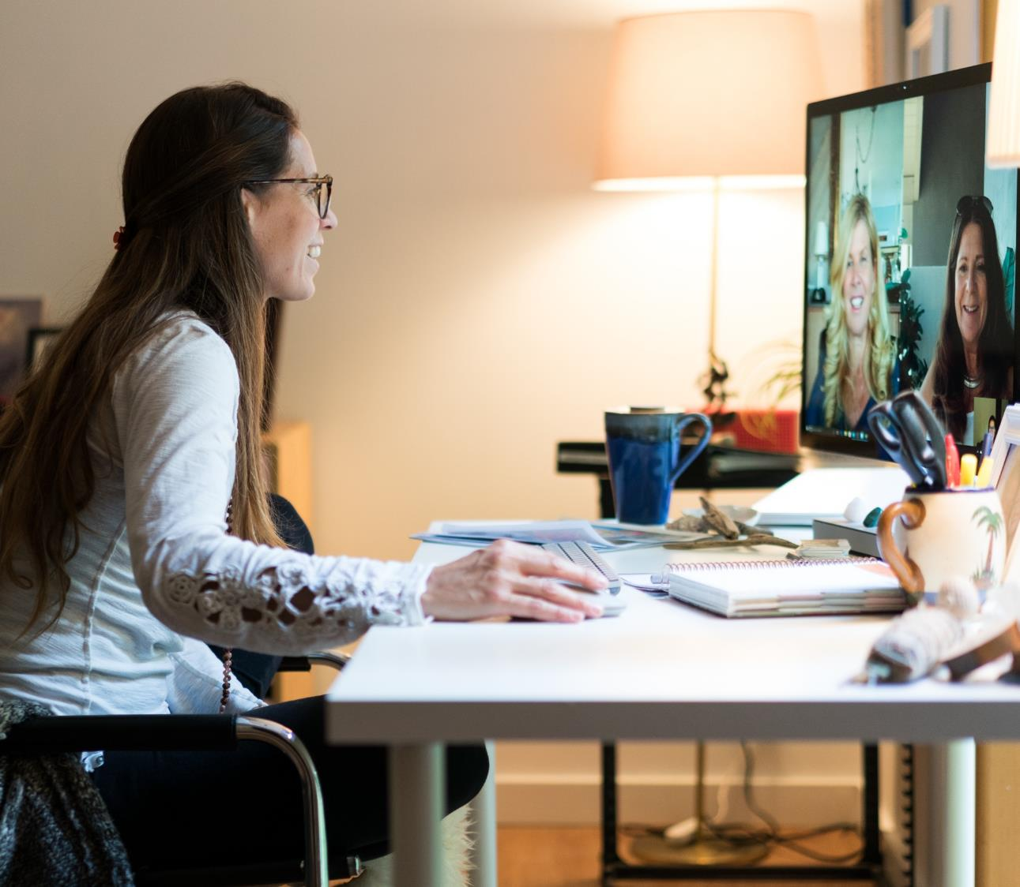
14 Speaker Preparation

Slide 2
Speaker Expectations
Meet deadlines/work from Repository
Access to Execs (support staff will “protect”)
Presenter Training Session – Mandatory
Presenter Dry Run/Rehearsal – Mandatory
Agree to A/V, Attire, Lighting Guidance

Slide 3
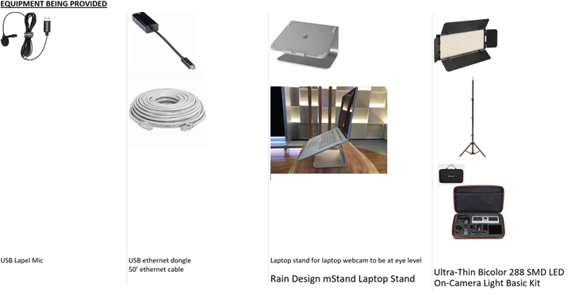
Consider a Speaker “Kit”

Slide 4
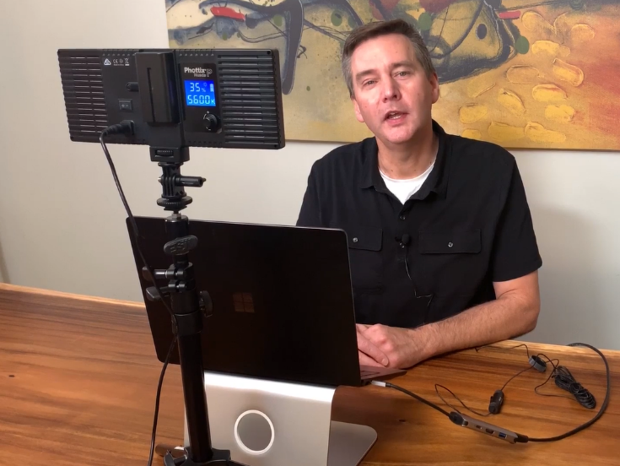
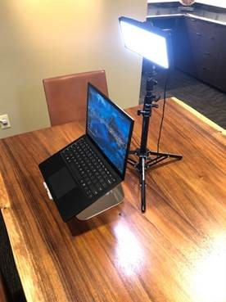
Consider a Speaker Kit

Slide 5
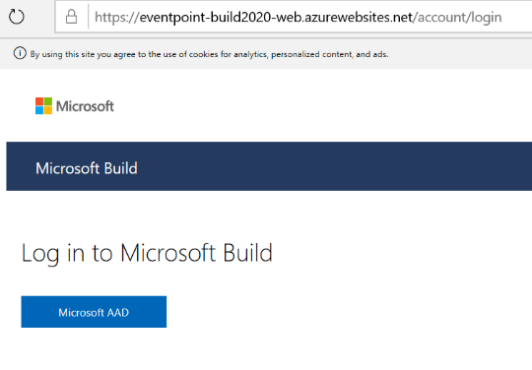
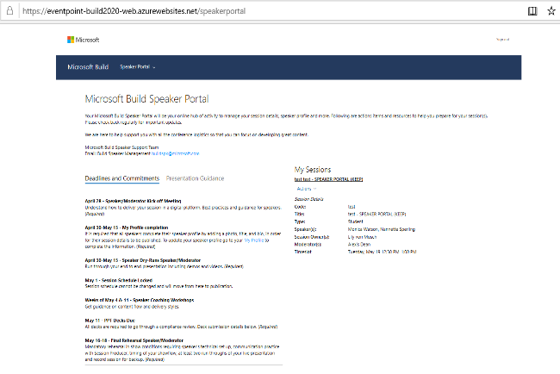
Speaker Portal / Community
Presenter Portal includes:
Single source of truth
Background templates
Session logistics and details
Links to guidance documents
Location and Instructions for content submission
Support contacts
Presenter Team / Office Hours
Speaker Alias or Channel
Bi-weekly Office Hours

Slide 6
Speaker Section of Virtual Event Playbook
Presenter Portal includes:
Single source of truth
Background templates
Session logistics and details
Links to guidance documents
Location and Instructions for content submission
Support contacts
Presenter Team / Office Hours
Speaker Alias or Channel
Bi-weekly Office Hours

